Slide 1
Muzix App
Movie Application

Slide 2



Team Members
Vipul Navale
Monali Sharma
Arjun Reddy

Slide 3
Introduction & Features
Muzix App is a movie streaming application where subscribed user will be able to watch vast collection of movies. It has features mentioned below :
1. Play Movies
4. Filter
- filter by Genre
- filter by language
2. Favourite Lists
- create favourite list
- delete favourite list
- add movie to favourite list
- delete movie to favourite list
5. Subscription
6. Notification Service
3. Search
7. Profile

Slide 4









Technologies Used
1. Front-End :
2. Back-End :
3. DataBase :

Slide 5
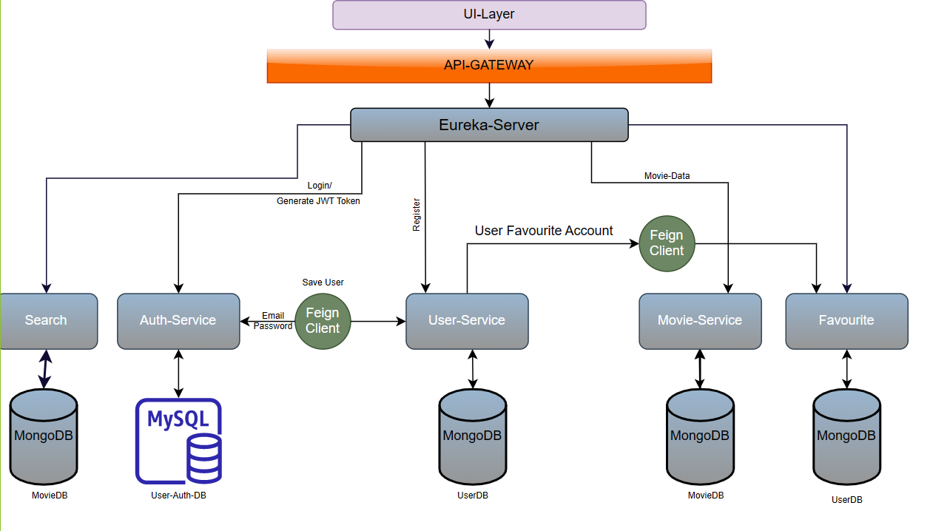
Architecture Diagram

Slide 6
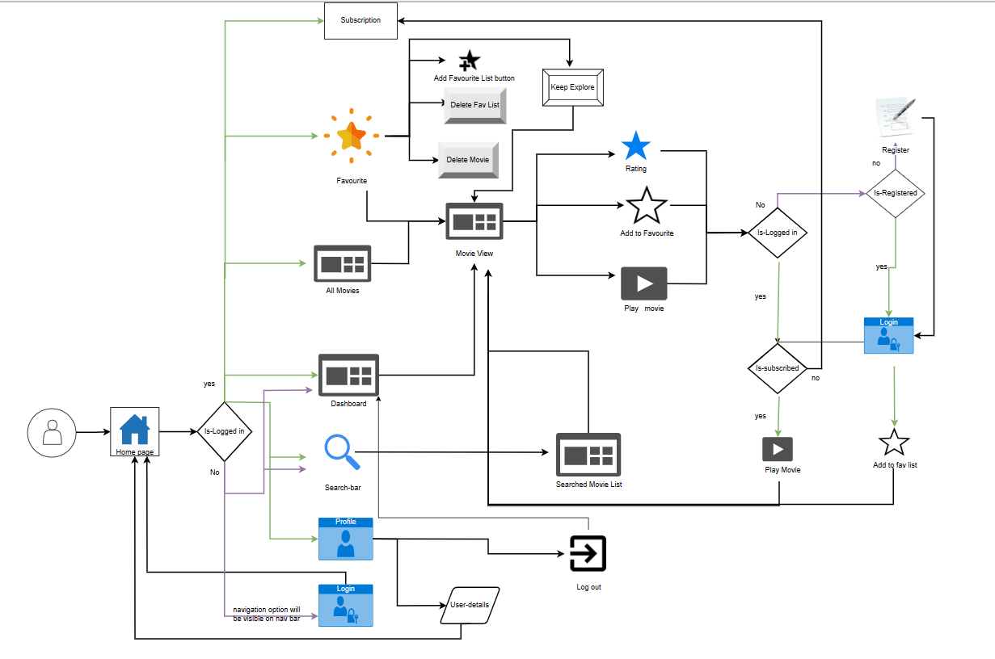
Flow Diagram

Slide 7
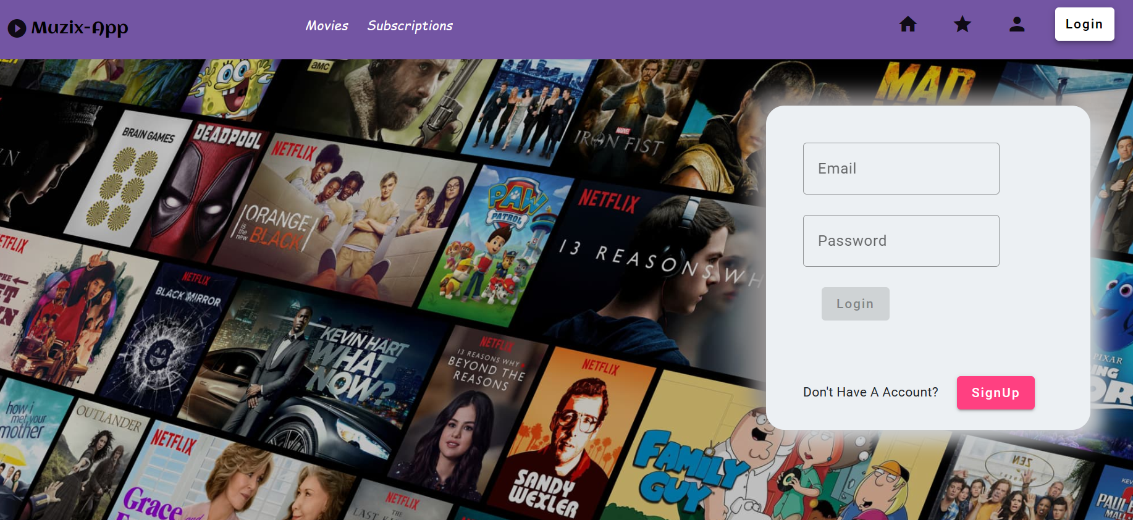
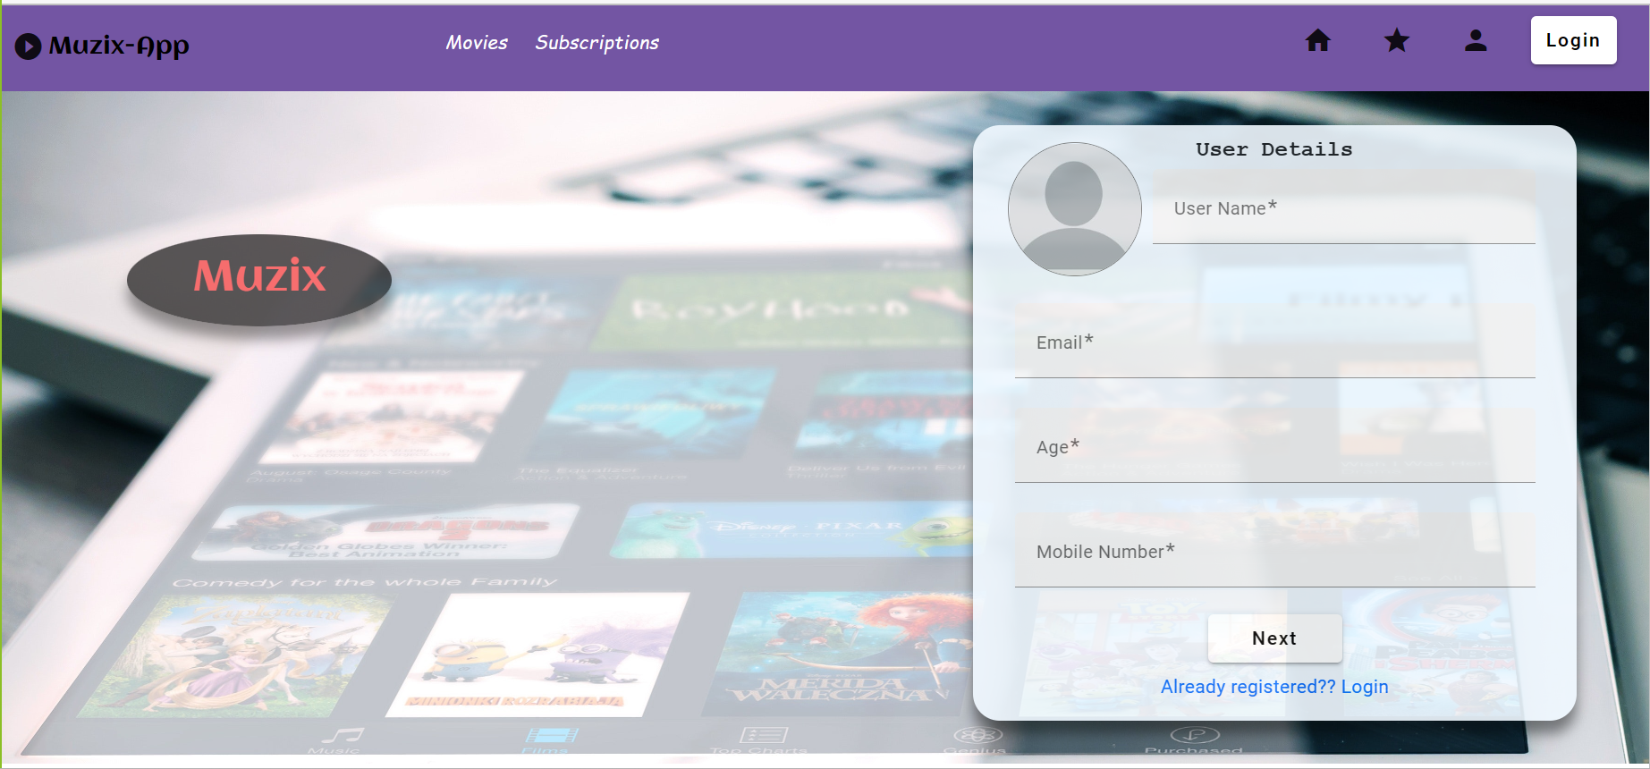
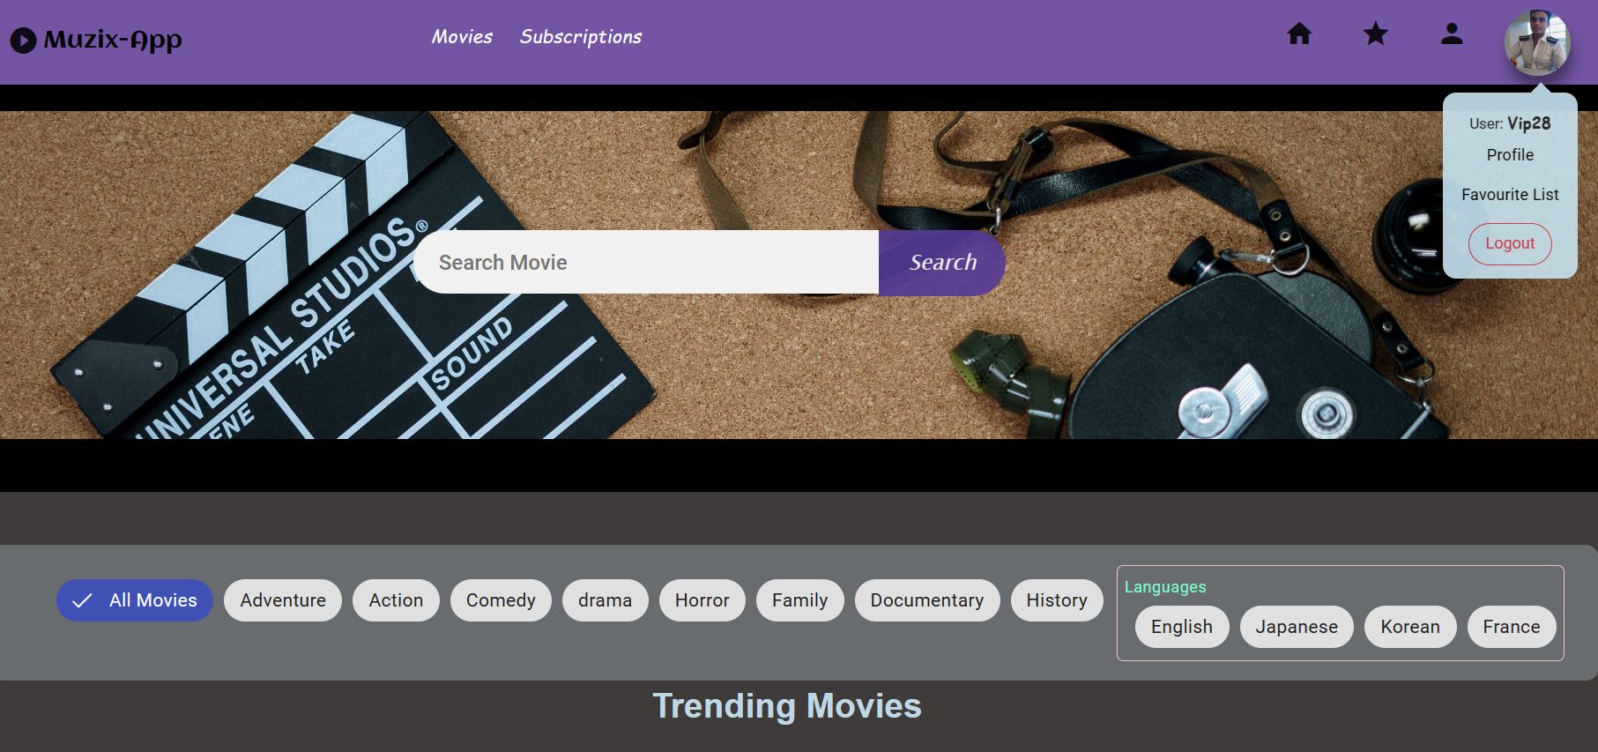
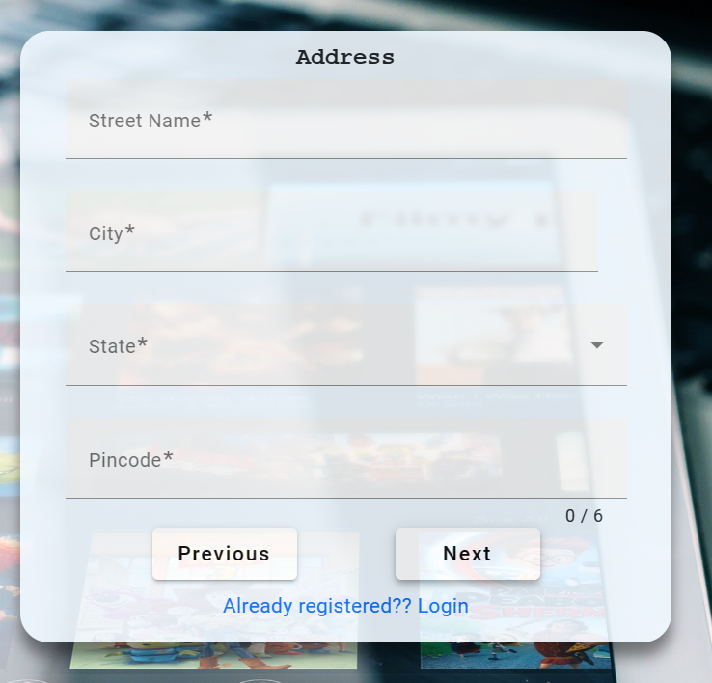
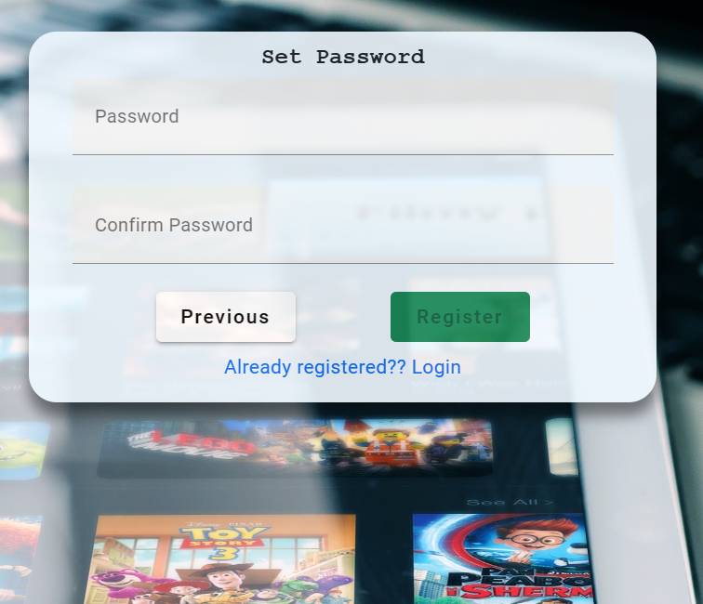
Login
Registration form
Dashboard

Slide 8
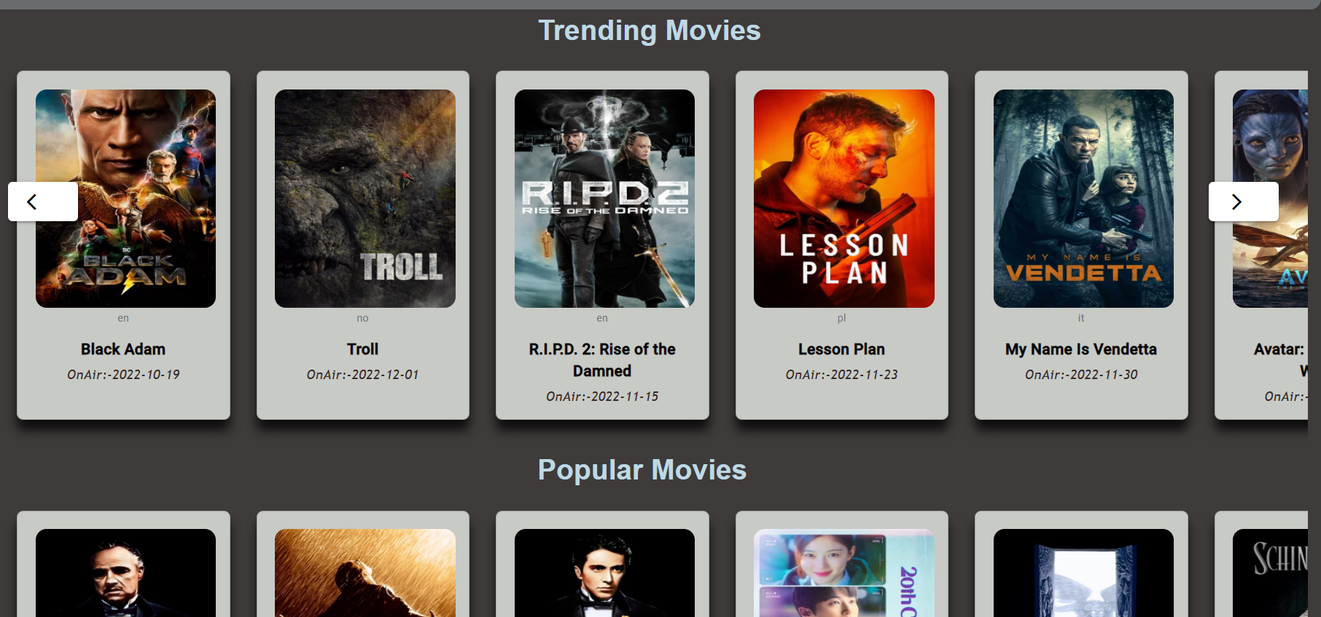
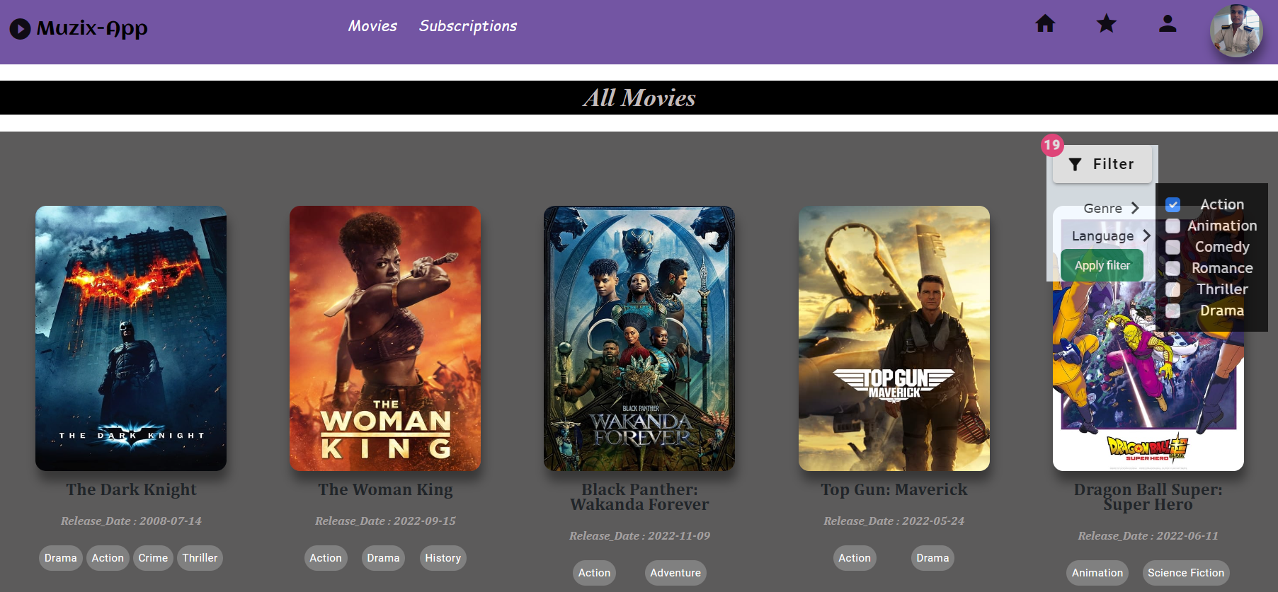
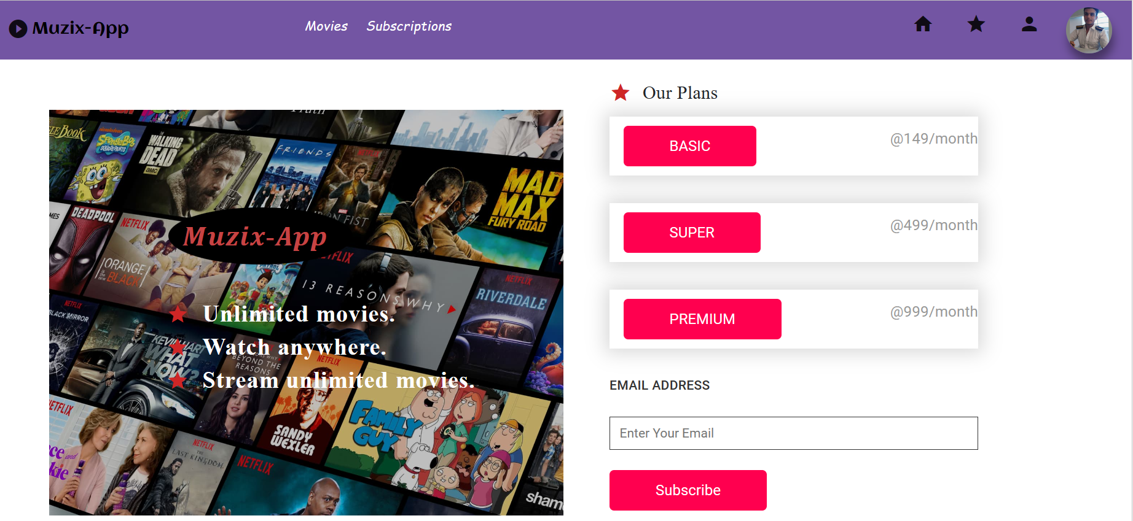
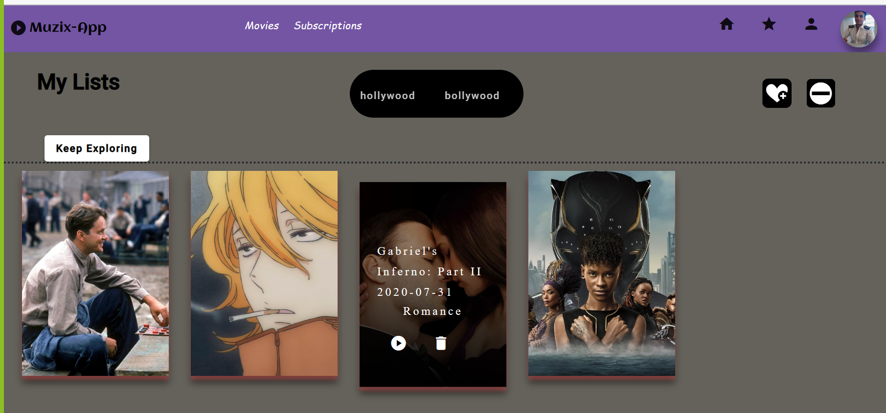

Slide 9
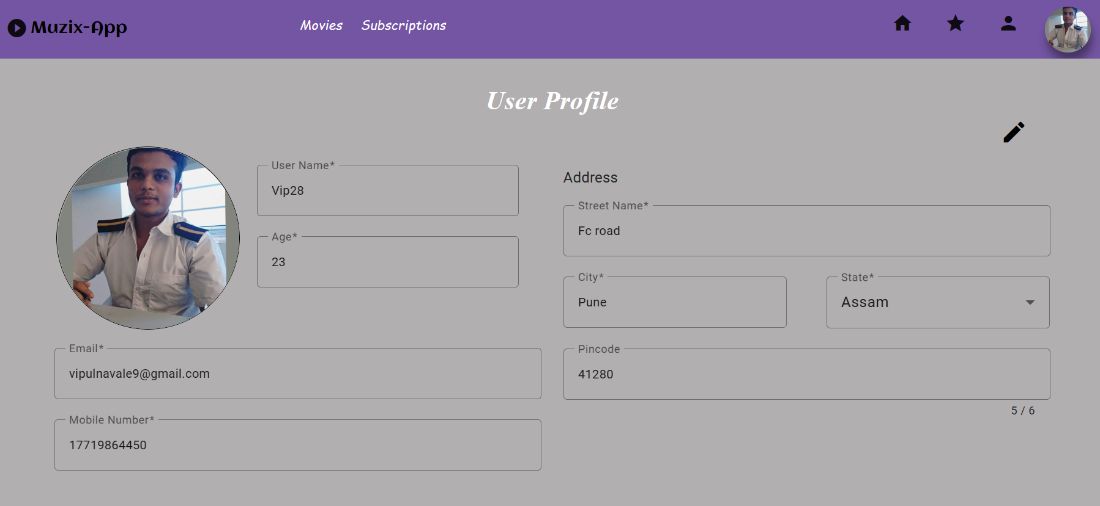
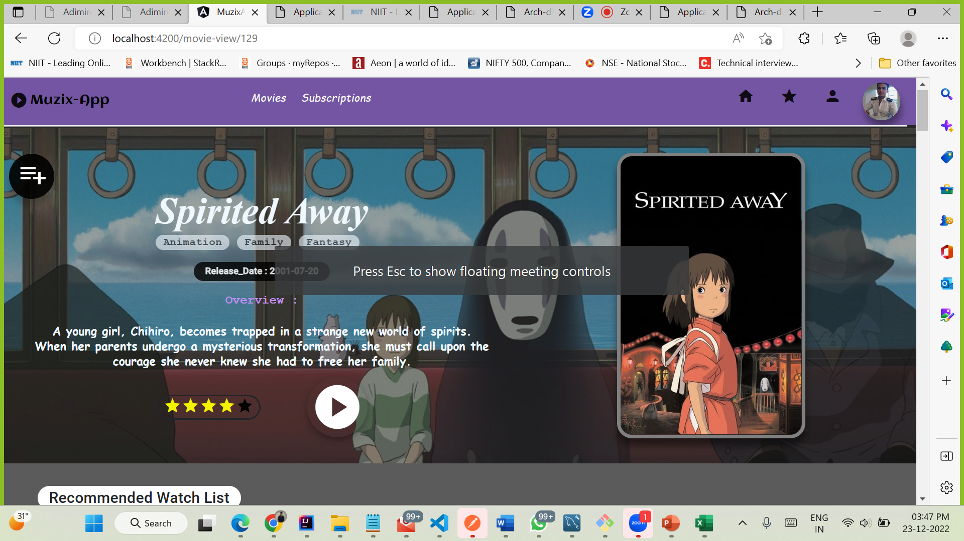
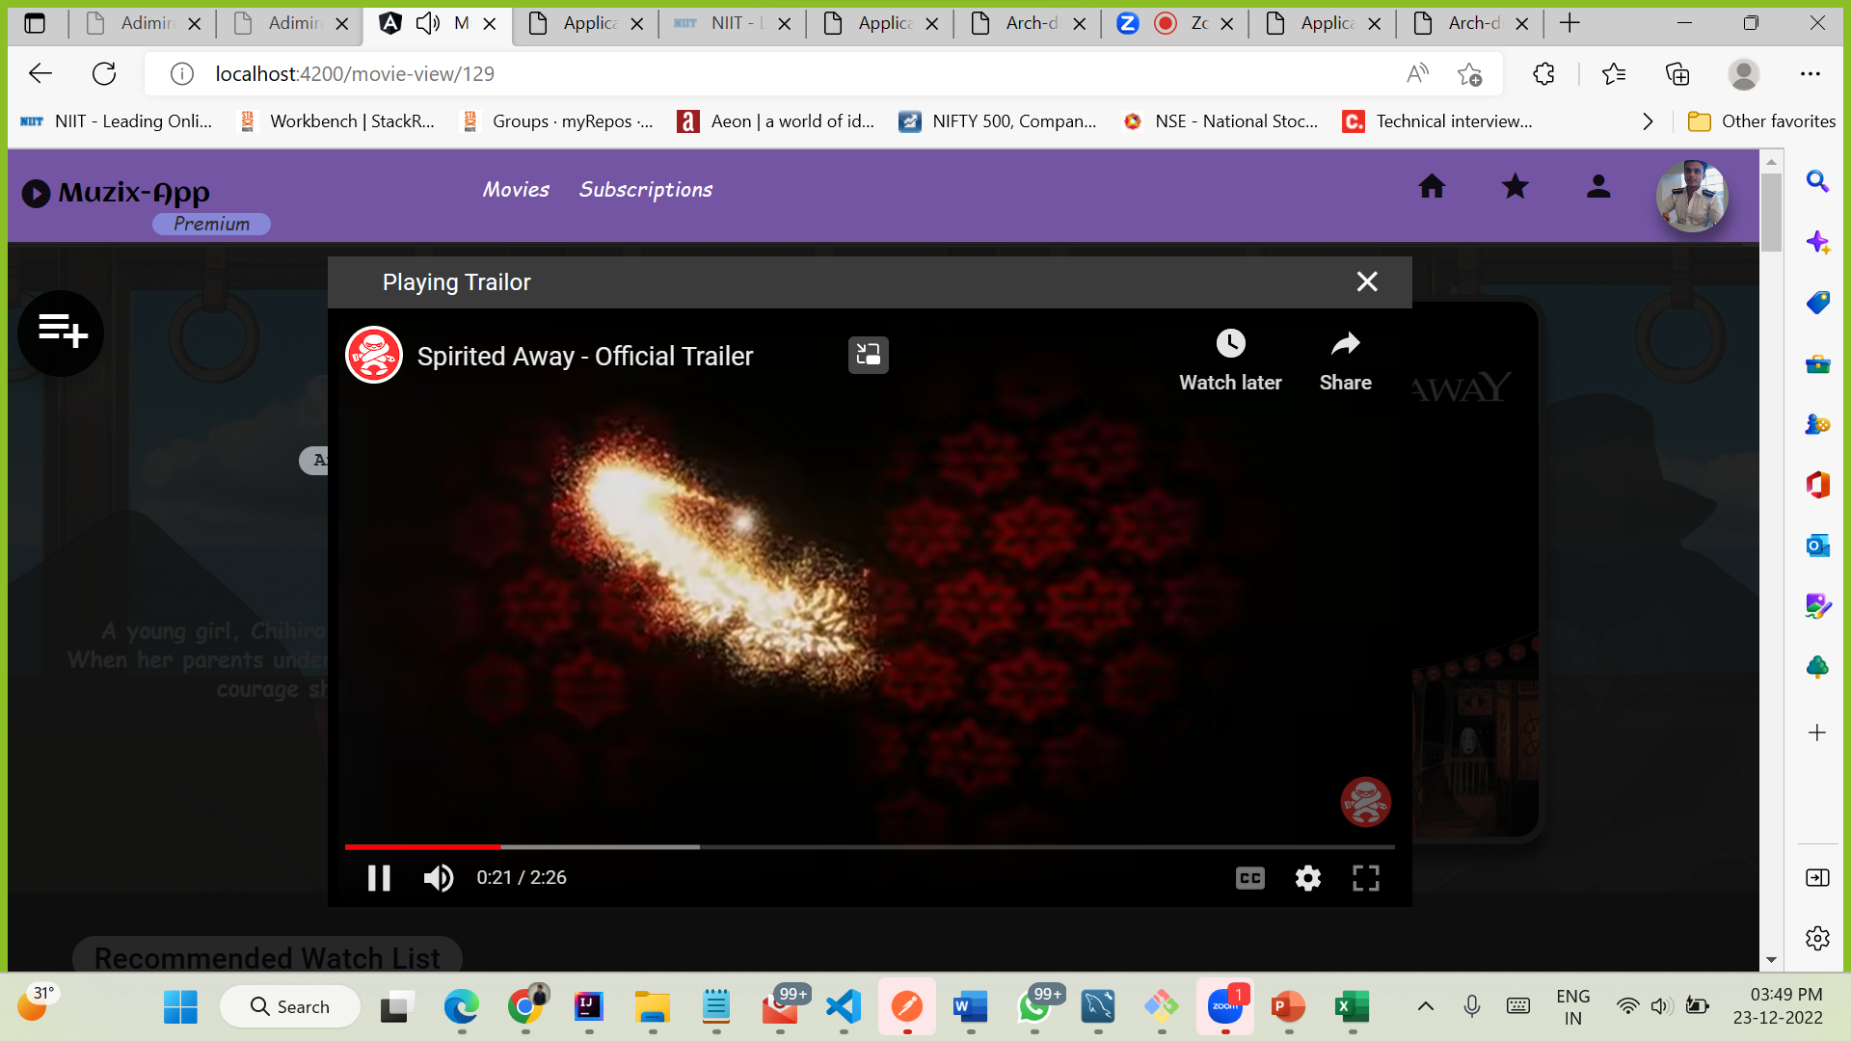

Slide 10
Future Enhancement
Multiple-Screen streaming in single account
Webseries & Tv-shows
Download option for Offline
Notification service on streaming new movies for subscribed users

Slide 11
Q & A

Slide 12
Thank You!

